Slide 1
Chapter 02 Number system and codes
Hari K.C.
Department of Software Engineering
Gandaki College of Engineering and Science

Slide 2
Number system
Definition: In digital electronics, the number system is used for representing the information.
The number system has different bases and the most common of them are the decimal, binary, octal, and hexadecimal.
The base or radix of the number system is the total number of the digit used in the number system.
Suppose if the number system representing the digit from 0 – 9 then the base of the system is the 10.

Slide 3
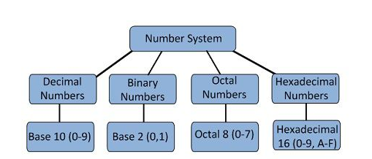
Types of Number Systems
Some of the important types of number system are
Decimal Number System
Binary Number System
Octal Number System
Hexadecimal Number System

Slide 4
1. Decimal Number Systems
The number system is having digit 0, 1, 2, 3, 4, 5, 6, 7, 8, 9; this number system is known as a decimal number system because total ten digits are involved.
The base of the decimal number system is 10.
2. Binary Number Systems
The modern computers do not process decimal number; they work with another number system known as a binary number system which uses only two digits 0 and1.
The base of binary number system is 2 because it has only two digit 0 and 1.
The digital electronic equipment's are works on the binary number system and hence the decimal number system is converted into binary system.

Slide 5
3. Octal Numbers
The base of a number system is equal to the number of digits used, i.e., for decimal number system the base is ten while for the binary system the base is two.
The octal system has the base of eight as it uses eight digits 0, 1, 2, 3, 4, 5, 6, 7.
All these digits from 0 to 7 have the same physical meaning as by decimal symbols, the next digit in the octal number is represented by 10, 11, 12, which are equivalent to decimal digits 8, 9, 10 respectively. In this way, the octal number 20 will represent the decimal digit and subsequently, 21, 22, 23..
Octal numbers will represent the decimal number digit 17, 18, 19… etc. and so on.

Slide 6
4. Hexadecimal Numbers
These numbers are used extensively in microprocessor work.
The hexadecimal number system has a base of 16, and hence it consists of the following sixteen number of digits.
0, 1, 2, 3, 4, 5, 6, 7, 8, 9, A, B, C, D, E, F.
The size of the hexadecimal is much shorter than the binary number which makes them easy to write and remember.
Let 0000 to 000F representing hexadecimal numbers from zero to fifteen, then 0010, 0011, 0012, …etc. Will represent sixteen, seventeen, eighteen… etc. till 001F which represent thirty open and so on.

Slide 7
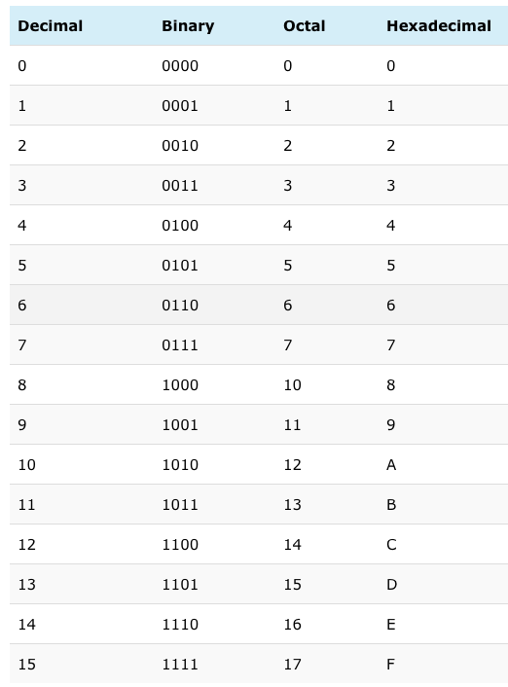

Slide 8
Binary to Decimal Conversion Methods
The decimal number system is represented by the digit 0, 1, 2, 3, 4, 5, 6, 7, 8, 9.
It consists ten digits and hence the base of the system is 10. Their base is increased by the factor of 10.
On the other hand, the binary number system consists only two digits 1 and 0.The base of the binary number system is 2, and it is increased by the factor of two.
The first digit has 2⁰ weights, the second has 2¹ weights, the weight of the third digit is 2² and so on.

Slide 9
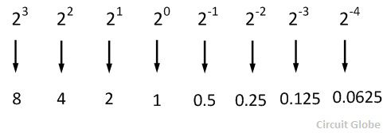
Consider a decimal number 3285 it can be written as:
3285 = 3000 + 200 + 80 + 5 3285 = 3(10³) + 2(10²) + 8(10¹) + 5(10⁰)
Thus the decimal number system is an example of positional notation where each digit position has a weight in terms of powers of ten.
Similarly, in the binary number system each digit position has a weight regarding powers of two.
Some of the examples of a binary digit are shown in the example.

Slide 10
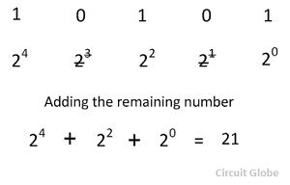
In binary to decimal conversion when there is one in a digit position of a binary number, then the weight of the position is added.
But when there is the zero in a binary position the weight of the position is disregarded.
Considered the conversion of the binary number 10101 into its equivalent decimal numbers

Slide 11
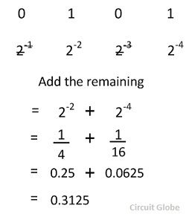
Binary to Decimal Conversion for Fractional Number

Slide 12
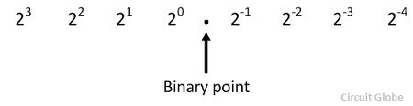
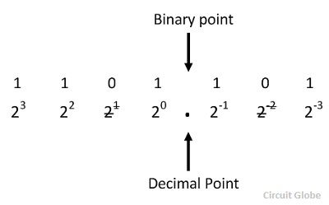
Binary to Decimal Conversion For Mixed Number
The number with an integer and fractional part are called mixed number. The weight for a mixed number can be written as
Consider the conversion of a binary number 1101.101 into its equivalents decimal number
After disregarding the weight 2¹ and 2⁻¹ and on summing up the remaining weights the required decimal number is 13.625.

Slide 13
Decimal to Binary Conversion Methods
The most popular way to convert a decimal number into the binary is the double dabble method. In this method, the given decimal number is progressively divided by 2 and writing the remainder after each division. When all the remainder is read in reverse order, the binary number is obtained.
Steps for Decimal to Binary Conversion
Step – 1 Divide the decimal number which is to be converted by two which is the base of the binary number. Step – 2 The remainder which is obtained from step 1 is the least significant bit of the new binary number. Step – 3 Divide the quotient which is obtained from the step 2 and the remainder obtained from this is the second least significant bit of the binary number. Step – 4 Repeat the process until the quotient remains zero. Step – 5 The last remainder obtained from the division is the most significant bit of the binary number. Hence arrange the number from most significant bit to the least significant bit (i.e., from bottom to top).

Slide 14
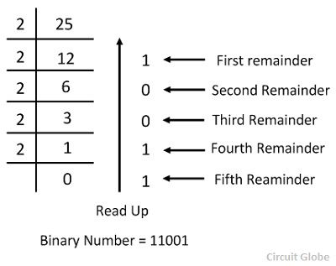
For example – Consider the conversion of the decimal number 25 into its equivalent binary.

Slide 15
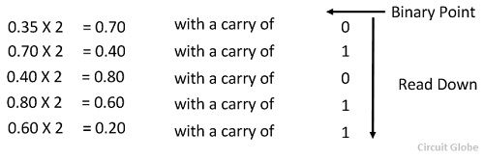
Conversion of Decimal to Binary for Fraction Number
For fractional decimal numbers, multiply it by 2 and record the carry in the integral position. The carries when read down produces the equivalent binary fraction as explained by the example given below.
Consider the fractional binary number 0.35
Thus the fractional binary number is .01011, i.e., 0.01011.

Slide 16
Conversion from Decimal to Octal number system
Convert decimal number (210)₁₀ into octal number
Since given number is decimal integer number performing short division by 8 with remainder.
Now, write remainder from bottom to up (in reverse order), this will be (322)₈ which is equivalent octal number of decimal integer 210.
Division | Remainder (R)
210 / 8 = 26 | 2
26 / 8 = 3 | 2
3 / 8 = 0 | 3

Slide 17
Q) Convert decimal fractional number (0.140869140625)₁₀ into octal number.
Since given number is decimal fractional number, so by using above algorithm performing short multiplication by 8 with integer part.
Now, write these resultant integer part, this will be approximate (0.11010 )₈which is equivalent octal fractional number of decimal fractional 0.140869140625.
Multiplication | Resultant integer part
0.140869140625 x 8=0.12695313 | 1
0.12695313 x 8=0.01562504 | 1
0.01562504 x 8=0.12500032 | 0
0.12500032 x 8=0.00000256 | 1
0.00000256 x 8=0.000020544 | 0
and so on ....

Slide 18
Octal to decimal conversion
The conversion can be performed in the conventional mathematical way, by showing each digit place as an increasing power of 8.
(345) ₈
=(3 * 8²) + (4 * 8¹) + (5 * 8⁰)
= (3 * 64) + (4 * 8) + (5 * 1)
= (229) ₁₀

Slide 19
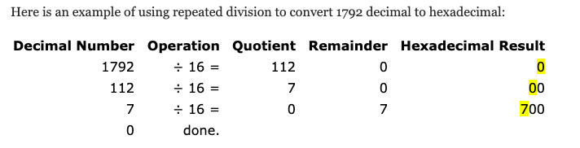
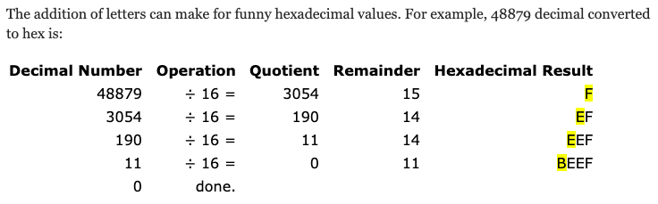
Decimal to hexadecimal conversion

Slide 20
Hexadecimal to decimal conversion
Converting hexadecimal to decimal can be performed in the conventional mathematical way, by showing each digit place as an increasing power of 16.
Of course, hexadecimal letter values need to be converted to decimal values before performing the math.
Hexadecimal: | 0 | 1 | 2 | 3 | 4 | 5 | 6 | 7
Decimal: | 0 | 1 | 2 | 3 | 4 | 5 | 6 | 7
Hexadecimal: | 8 | 9 | A | B | C | D | E | F
Decimal: | 8 | 9 | 10 | 11 | 12 | 13 | 14 | 15

Slide 21
(A2DE) ₁₆
= ((A) * 16³) + (2 * 16²) + ((D) * 16¹) + ((E) * 16⁰)
= (10 * 16³) + (2 * 16²) + (13 * 16¹) + (14 * 16⁰)
= (10 * 4096) + (2 * 256) + (13 * 16) + (14 * 1)
= 40960 + 512 + 208 + 14
= (41694) ₁₀

Slide 22
Binary to Octal conversion
So, these are following steps to convert a binary number into octal number.
Take binary number
Divide the binary digits into groups of three (starting from right) for integer part and start from left for fraction part.
Convert each group of three binary digits to one octal digit.

Slide 23
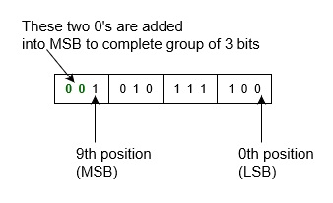
Convert binary number (1010111100)₂ into octal number.
Since there is no binary point here and no fractional part.
So, Therefore, Binary to octal is.
= (1010111100)₂ = (001 010 111 100)₂ = (1 2 7 4)₈ = (1274)₈

Slide 24
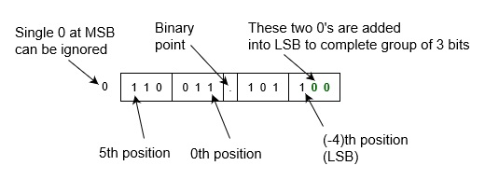
Convert binary number 0110 011.1011 into octal number.
Since there is binary point here and fractional part.
So,
Therefore, Binary to octal is.
= (0110 011.1011)₂ = (0 110 011 . 101 1)₂ = (110 011 . 101 100)₂
= (6 3 . 5 4)₈ = (63.54)₈

Slide 25
Octal to Binary conversion
There is a simple direct method to convert an octal number to binary number.
Since there are only 8 symbols (i.e., 0, 1, 2, 3, 4, 5, 6, and 7) in octal representation system and its base (i.e., 8) is equivalent of 23=8.
So, you can represent each digit of octal in group of 3 bits in binary number.
Octal Symbol | Binary equivalent
0 | 000
1 | 001
2 | 010
3 | 011
4 | 100
5 | 101
6 | 110
7 | 111

Slide 26
This method is simple and also works as reverse of Binary to Octal Conversion. The algorithm is explained as following below.
Take Octal number as input
Convert each digit of octal into binary.
That will be output as binary number.
Q) Convert octal number (540)₈ into binary number.
According to above algorithm, equivalent binary number will be,
= (540)₈
= (101 100 000)₂
= (101100000)₂

Slide 27
Q) Convert octal number (352.563)₈ into binary number.
According to above algorithm, equivalent binary number will be,
= (352.563)₈
= (011 101 010 . 101 110 011)₂
= (011101010.101110011)₂

Slide 28
Hexadecimal to binary number conversion
Example 1:
(2C1)₁₆ = (?)₂
2 C 1
=0010 1100 0001
=(1011000001)₂
Example 2: (9DB2)₁₆ = (?)₂
= 9 D B 2
=1001 1101 1011 0010
=(1001110110110010) ₂

Slide 29
Binary to hexadecimal conversion
Example − Convert binary number 1101010 into hexadecimal number.
First convert this into decimal number:
= (1101010)₂
= 1x2⁶+1x2⁵+0x2⁴+1x2³+0x2²+1x2¹+0x2⁰
= 64+32+0+8+0+2+0
= (106)₁₀
Then, convert it into hexadecimal number
= (106)₁₀ = 6x16¹+10x16⁰ = (6A)₁₆ which is answer.

Slide 30
Convert binary number 1010101101001 into hexadecimal number.
= (1010101101001)₂
= (1 0101 0110 1001)₂
= (0001 0101 0110 1001)₂
= (1 5 6 9)₁₆
= (1569)₁₆
Convert binary number 001100101.110111 into hexadecimal number
= (001100101.110111)₂
= (0 0110 0101 . 1101 1100)₂
= (0110 0101 . 1101 1100)₂
= (6 5 . D C)₁₆
= (65.DC)₁₆

Slide 31
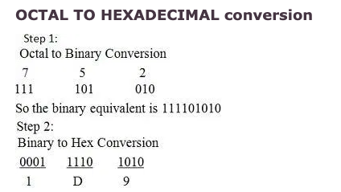
Octal to hexadecimal conversion

Slide 32
Convert 536 from octal to hexadecimal number
➔Converting 536(octal) into its binary equivalent ,we get (536)₈ = (101) (011) (110) =(101011110)₂ Now forming the group of 4 binary bits to obtain its hexadecimal equivalent, (101011110)₂= (0001) (0101) (1110) = (15E)₁₆
So the hexadecimal number of 536 is 15E.

Slide 33
Hexadecimal to octal conversion
Example: Convert 1BC₁₆ into an octal number.
Solution: Given, 1BC₁₆ is a hexadecimal number.
1 → 0001, B → 1011, C →1100
Now group them from right to left, each having 3 digits.
000, 110, 111, 100
000→0, 110 →6, 111→7, 100→4
Hence, 1BC₁₆ = 674₈

Slide 34
Perform the following?
1. (478)₁₀ = ( ? )₆
2. (110101) = (53)_{x.} find x ?

Slide 35
CODES used in Computer system
BCD Codes
Gray codes
XS3 codes
Alphanumeric codes

Slide 36
BCD codes
Binary Coded Decimal or BCD is simply the 4-bit binary code representation of a decimal digit with each decimal digit replaced in the integer and fractional parts with its binary equivalent.
BCD Code uses four bits to represent the 10 decimal digits of 0 to 9.
Standard binary coded decimal code is commonly known as a weighted 8421 BCD code, with 8, 4, 2 and 1 representing the weights of the different bits starting from the most significant bit (MSB) and proceeding towards the least significant bit (LSB).
The weights of the individual positions of the bits of a BCD code are: 2³ = 8, 2² = 4, 2¹ = 2, 2⁰ = 1.
The main advantage of the Binary Coded Decimal system is that it is a fast and efficient system to convert the decimal numbers into binary numbers as compared to the pure binary system. But the BCD code is wasteful as many of the 4-bit states (10-to-16) are not used but decimal displays have important applications.

Slide 37
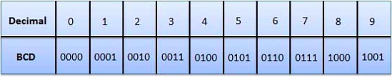
Advantages of BCD Codes
It is very similar to decimal system.
We need to remember binary equivalent of decimal numbers 0 to 9 only.
Disadvantages of BCD Codes
The addition and subtraction of BCD have different rules.
The BCD arithmetic is little more complicated.
BCD needs more number of bits than binary to represent the decimal number. So BCD is less efficient than binary.
Applications
used in digital voltmeter
used in digital clock
used in traditional computer

Slide 38
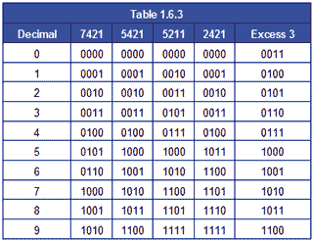
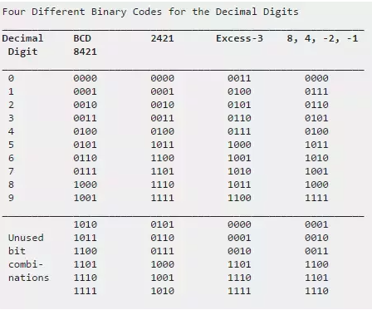

Slide 39
BCD is different from converting a decimal number to binary.
For example, 45, when converted to binary, is 101101,
when represented in BCD is 01000101.
The main advantage of the Binary Coded Decimal system is that it is a fast and efficient system to convert the decimal numbers into binary numbers as compared to the pure binary system.
But the BCD code is wasteful as many of the 4-bit states (10-to-16) are not used but decimal displays have important applications.
The BIOS in many personal computers stores the date and time in BCD because the MC6818 real-time clock chip used in the original IBM PC AT motherboard provided the time encoded in BCD. This form is easily converted into ASCII for display.[4]
The Atari 8-bit family of computers used BCD to implement floating-point algorithms. The MOS 6502 processor used has a BCD mode that affects the addition and subtraction instructions.
Early models of the PlayStation 3 store the date and time in BCD. This led to a worldwide outage of the console on 1st march 2010. The last two digits of the year stored as BCD were misinterpreted as 16 causing a paradox in the unit's date, rendering most functionalities inoperable

Slide 40
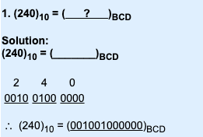
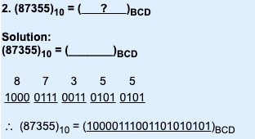
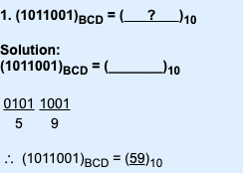
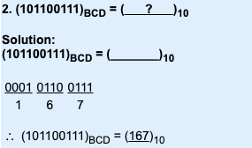
Conversion from decimal to BCD and vice-versa

Slide 41
BCD addition
The addition of BCD numbers is slightly different from binary addition.
Here, the rules of binary addition are partially applicable only to the individual 4-bit groups.
The BCD addition, is thus carried out by individually adding the corresponding 4-bit groups starting from the LSB side and
if there is a carry to the next group, or if the result belongs to any of the 6 illegal states than we add 6₁₀(0110) to the sum term of that group and resulting carry is added in the next group.

Slide 42
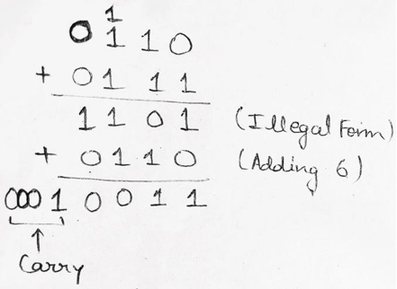
Example: Perform BCD Addition of 6 and 7.
Solution: BCD representation of 6 is given as 0110 and for 7 it is 0111
When we add 6 and 7 in BCD, we get 1101 which is an invalid state therefore, we add 0110 (6) to the sum to get correct result which is 0001 0011 (13).

Slide 43
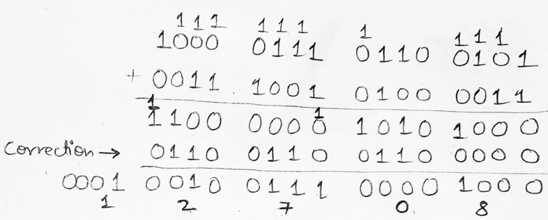
Example 2: Perform BCD Addition of 8765 and 3943.
Solution:
BCD representation of 8765 is given as 1000 0111 0110 0011 and for 3943 it is 0011 1001 0100 0011.

Slide 44
Firstly, we will perform a normal binary addition of two numbers now we see 1100 and 1010 which are illegal states also the third group of 4-bits from LSB side i.e., 0000 has a carry 1 to the next group.
So, for correction, we have to add 0110 to all three groups. Thus, we get the correct result as 0001 0010 0111 0000 1000 which is equivalent to (12708)₁₀ in decimal number system and this is what we get on adding (8765)₁₀ + (3943)₁₀ = (12708)₁₀.
Hence, our result is also verified.

Slide 45
Gray code
The reflected binary code or Gray code is an ordering of the binary numeral system such that two successive values differ in only one bit (binary digit).
Gray codes are very useful in the normal sequence of binary numbers generated by the hardware that may cause an error or ambiguity during the transition from one number to the next.
So, the Gray code can eliminate this problem easily since only one bit changes its value during any transition between two numbers.
Gray code is not weighted that means it does not depends on positional value of digit.
This cyclic variable code that means every transition from one value to the next value involves only one bit change.

Slide 46
For n = 1 bit |  | For n = 2 bit |  | For n = 3 bit
Binary | Gray | Binary | Gray | Binary | Gray
0 | 0 | 00 | 00 | 000 | 000
1 | 1 | 01 | 01 | 001 | 001
 |  | 10 | 11 | 010 | 011
 |  | 11 | 10 | 011 | 010
 |  |  |  | 100 | 110
 |  |  |  | 101 | 111
 |  |  |  | 110 | 101
 |  |  |  | 111 | 100

Slide 47
Decimal | Binary | Gray Code
0 | 000 | 000
1 | 001 | 001
2 | 010 | 011
3 | 011 | 010
4 | 100 | 110
5 | 101 | 111
6 | 110 | 101
7 | 111 | 100

Slide 48
Gray codes are widely used to prevent spurious output from electromechanical switches and to facilitate error correction in digital communications such as digital terrestrial television and some cable TV systems.
It is also used for asynchronous FIF0 pointer.
Used for high speed decode circuit.
When Gray code are used in computers to address program memory , the computer uses less power because fever address line change as the program counter advances.
Gray code also play a vital role in error correction.

Slide 49
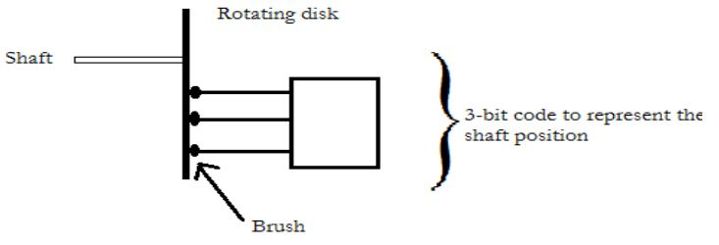
a) Consider an application where 3- bit binary code is provide to indicate position of the rating disk with the help of brushes.
b) When brushes are on the black position, they output a 1. When on the white position, they output a 0.
c) Now, consider what happen when the brushes are on 111 sector and almost to enter 000 sector.
d) If one brushes slightly ahead to other, say the 3rd brush, then the position indicated 011 instead of 000 or 111. This, result in 1800 error in the disk position.
e) Since it is physically impossible to have all the brushes precisely aligned, some error will always be present at the edge of sector.
f) If we use Gray code to represent disk position then error due to improper brush alignment can be reduced. This is because the gray code assures that only one bit will change at one time the decimal number is incremented.
So, in 3- bit code, error may occur due to one bit position. Other two bit position of two adjacent sector are always same and hence no possibility of error.

Slide 50
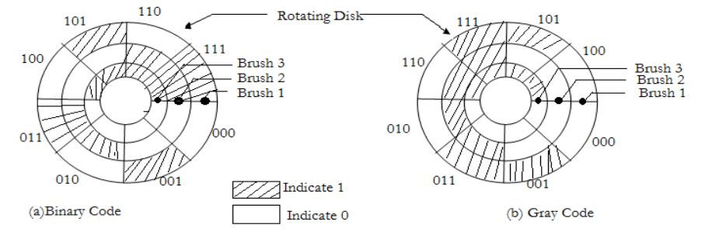
Therefore, In 3- bit code probability of error is reduced upto 66%. This is important advantage of Gray code and in 4- bit code is reduced upto 75%.

Slide 51
Excess-3 code (XS3)
The excess-3 code (or XS3) is a non-weighted code used to express code used to express decimal numbers.
It is a self-complementary binary coded decimal (BCD) code and numerical system which has biased representation.
It is particularly significant for arithmetic operations as it overcomes shortcoming encountered while using 8421 BCD code to add two decimal digits whose sum exceeds 9.
Excess-3 arithmetic uses different algorithm than normal non-biased BCD or binary positional number system.

Slide 52
Excess-3 codes are unweighted and can be obtained by adding 3 to each decimal digit then it can be represented by using 4 bit binary number for each digit. An Excess-3 equivalent of a given binary binary number is obtained using the following steps:
Find the decimal equivalent of the given binary number.
Add +3 to each digit of decimal number.
Convert the newly obtained decimal number back to binary number to get required excess-3 equivalent.
You can add 0011 to each four-bit group in binary coded decimal number (BCD) to get desired excess-3 equivalent

Slide 53
Decimal Digit | BCD Code | Excess-3 Code
0 | 0000 | 0011
1 | 0001 | 0100
2 | 0010 | 0101
3 | 0011 | 0110
4 | 0100 | 0111
5 | 0101 | 1000
6 | 0110 | 1001
7 | 0111 | 1010
8 | 1000 | 1011
9 | 1001 | 1100

Slide 54
Example-1 −Convert decimal number 23 to Excess-3 code.
So, according to excess-3 code we need to add 3 to both digit in the decimal number then convert into 4-bit binary number for result of each digit. Therefore,
= 23+33=56 =0101 0110 which is required excess-3 code for given decimal number 23.
Example-2 −Convert decimal number 15.46 into Excess-3 code.
According to excess-3 code we need to add 3 to both digit in the decimal number then convert into 4-bit binary number for result of each digit. Therefore,
= 15.46+33.33=48.79 =0100 1000.0111 1001 which is required excess-3 code for given decimal number 15.46.

Slide 55
Example − Convert Excess-3 code 1001001 into BCD and decimal number.
So, grouping 4-bit for each group, i.e., 0100 1001 and subtract 0011 0011 from given number. Therefore,
= 0100 1001 -0011 0011 =0001 0110
So, binary coded decimal number is 0001 0110 and decimal number will be 16.

Slide 56
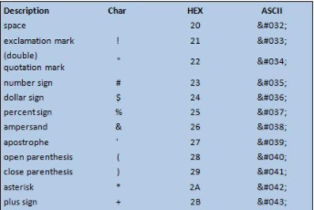
ASCII code
ASCII, stands for American Standard Code for Information Interchange.
It's a 7-bit character code where every single bit represents a unique character.

Slide 57
Text files stored in ASCII format are sometimes called ASCII files.
Text editors and word processors are usually capable of storing data in ASCII format, although ASCII format is not always the default storage format.
Most data files, particularly if they contain numeric data, are not stored in ASCII format. Executable programs are never stored in ASCII format.
It is a code for representing 128 English characters as numbers, with each letter assigned a number from 0 to 127.
For example, the ASCII code for uppercase M is 77. Most computers use ASCII codes to represent text, which makes it possible to transfer data from one computer to another.

Slide 58
Complements
Complements are used in the digital computers in order to simplify the subtraction operation and for the logical manipulations.
For each radix-r system (radix r represents base of number system) there are two types of complements.
S.N. | Complement | Description
1 | Radix Complement | The radix complement is referred to as the r's complement
2 | Diminished Radix Complement | The diminished radix complement is referred to as the (r-1)'s complement

Slide 59
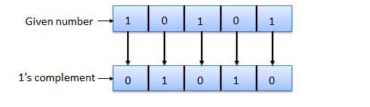
Binary system complements
1's complement
The 1's complement of a number is found by changing all 1's to 0's and all 0's to 1’s.
This is called as taking complement or 1's complement. Example of 1's Complement is as follows:

Slide 60
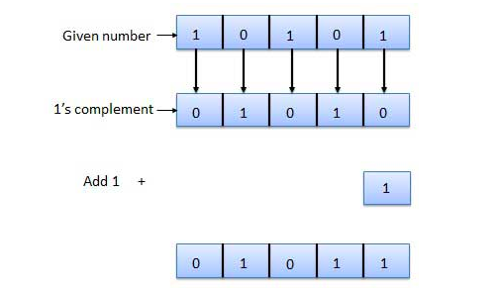
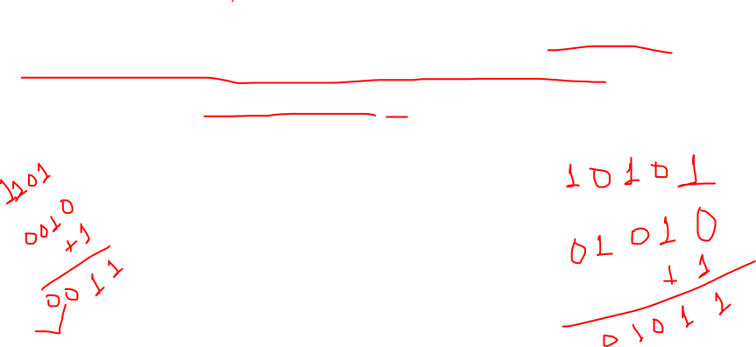
2's complement
The 2's complement of binary number is obtained by adding 1 to the Least Significant Bit (LSB) of 1's complement of the number.
2's complement = 1's complement + 1
Example of 2's Complement is as follows:

Slide 61
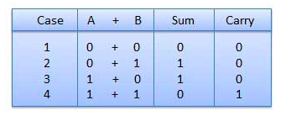
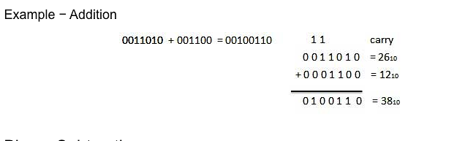
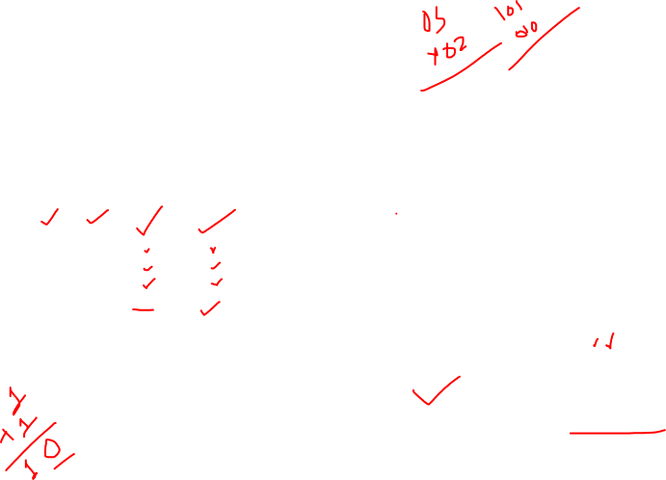
Binary Addition
It is a key for binary subtraction, multiplication, division. There are four rules of binary addition.

Slide 62
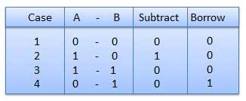
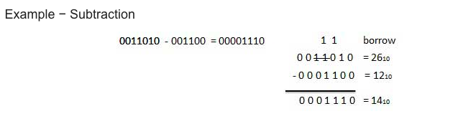
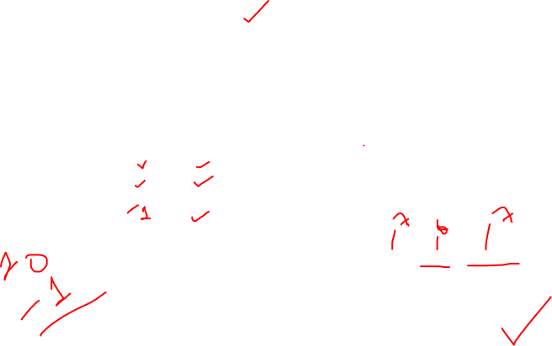
Binary Subtraction
Subtraction and Borrow, these two words will be used very frequently for the binary subtraction.
There are four rules of binary subtraction.

Slide 63
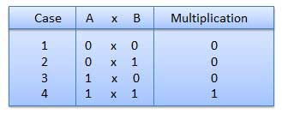
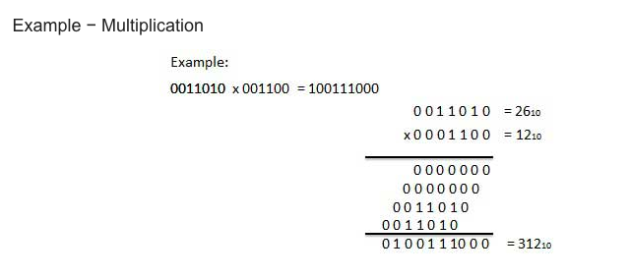
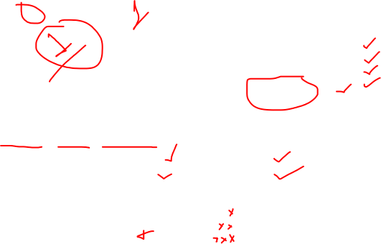
Binary Multiplication

Slide 64
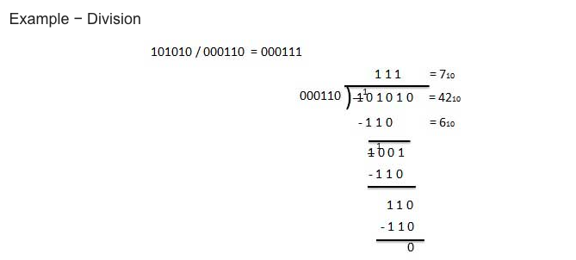

Binary Division
Binary division is similar to decimal division.
It is called as the long division procedure.

Slide 65
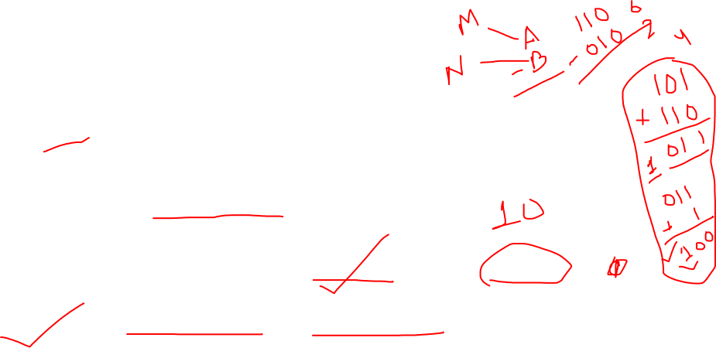
1’s Complement Subtraction
In subtraction by 1’s complement we subtract two binary numbers using carried by 1’s complement.
The steps to be followed in subtraction by 1’s complement are:
i) write down 1’s complement of the subtrahend.
ii) add this with the minuend.
iii) If the result of addition has a carry over then it is dropped and an 1 is added in the last bit.
iv) If there is no carry over, then 1’s complement of the result of addition is obtained to get the final result and it is negative.

Slide 66
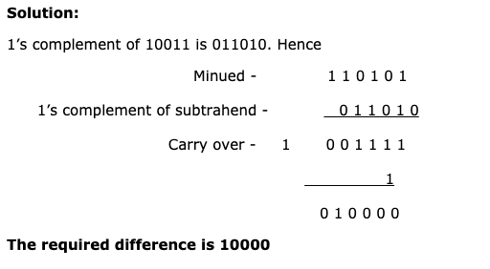
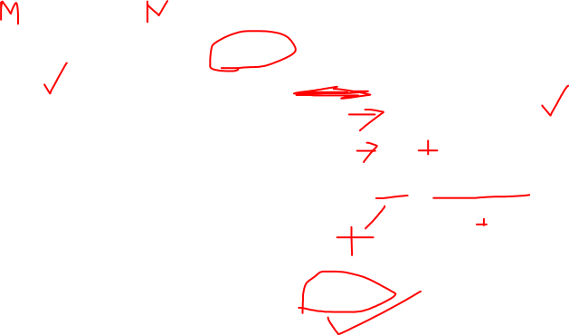
Evaluate: 110101 – 100101
100101

Slide 67
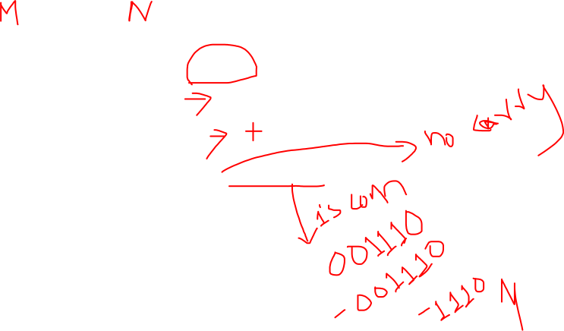
101011 – 111001
Solution:
1’s complement of 111001 is 000110. Hence
Minued - 1 0 1 0 1 1 1’s complement - 0 0 0 1 1 0 1 1 0 0 0 1
Hence the difference is – 1 1 1 0

Slide 68
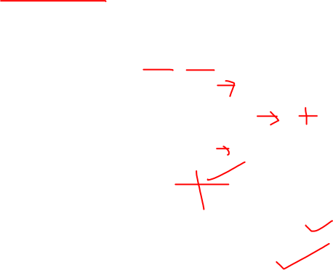
1011.001 – 110.10
Solution:
1’s complement of 0110.100 is 1001.011 Hence
Minued - 1 0 1 1 . 0 0 1 1’s complement of subtrahend - 1 0 0 1 . 0 1 1 Carry over - 1 0 1 0 0 . 1 0 0 1 0 1 0 0 . 1 0 1
Hence the required difference is 100.101

Slide 69
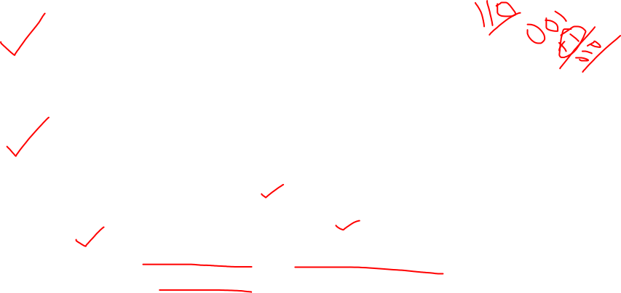
Subtraction by 2’s Complement
With the help of subtraction by 2’s complement method we can easily subtract two binary numbers.
The operation is carried out by means of the following steps:
(i) At first, 2’s complement of the subtrahend is found.
(ii) Then it is added to the minuend.
(iii) If the final carry over of the sum is 1, it is dropped and the result is positive.
(iv) If there is no carry over, the two’s complement of the sum will be the result and it is negative.

Slide 70
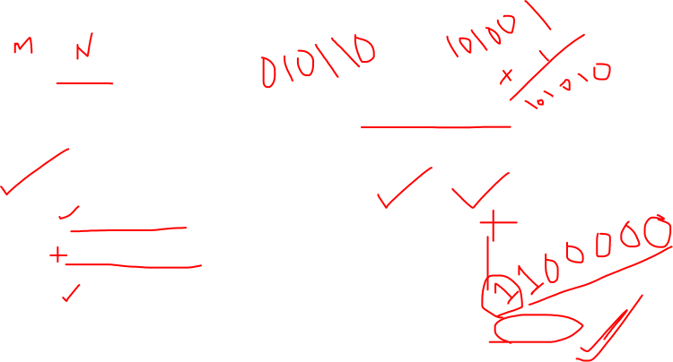
Evaluate:
(i) 110110 - 10110
Solution:
The numbers of bits in the subtrahend is 5 while that of minuend is 6. We make the number of bits in the subtrahend equal to that of minuend by taking a `0’ in the sixth place of the subtrahend.
Now, 2’s complement of 010110 is (101101 + 1) i.e.101010. Adding this with the minuend.
1 1 0 1 1 0 Minuend 1 0 1 0 1 0 2’s complement of subtrahend Carry over 1 1 0 0 0 0 0 Result of addition
After dropping the carry over we get the result of subtraction to be 100000.

Slide 71
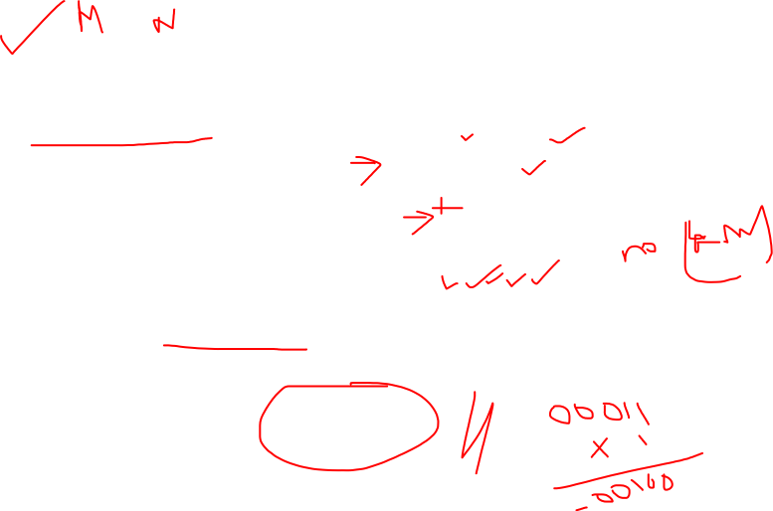
10110 – 11010
Solution:
2’s complement of 11010 is (00101 + 1) i.e. 00110. Hence
Minued - 1 0 1 1 0 2’s complement of subtrahend - 0 0 1 1 0 Result of addition - 1 1 1 0 0
As there is no carry over, the result of subtraction is negative and is obtained by writing the 2’s complement of 11100 i.e.(00011 + 1) or 00100.
Hence the difference is – 100.

Slide 72
1010.11 – 1001.01
Solution:
2’s complement of 1001.01 is 0110.11. Hence
Minued - 1 0 1 0 . 1 1 2’s complement of subtrahend - 0 1 1 0 . 1 1 Carry over 1 0 0 0 1 . 1 0
After dropping the carry over we get the result of subtraction as 1.10.

Slide 73
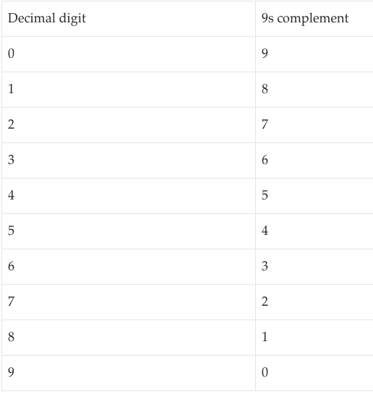
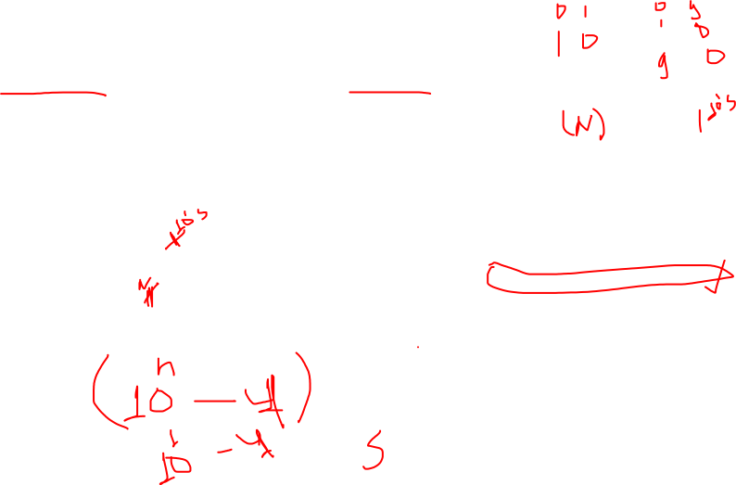
9’s Complement and 10’s Complement
The complements are used to make the arithmetic operations in digital system easier.
To obtain the 9’s complement of any number we have to subtract the number with (10^{n} – 1) where n = number of digits in the number.

Slide 74
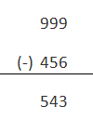


It is relatively easy to find out the 10’s complement after finding out the 9’s complement of that number.
We have to add 1 with the 9’s complement of any number to obtain the desired 10’s complement of that number.
Let us take a decimal number 456, 9’s complement of this number will be:
10’s complement of this number is:

Slide 75



Subtraction using 9’s
9’s complement subtraction
➔Let A = 215, B = 155
First we have to find out 9’s complement of B
Now we have to add 9’s complement of B to A

Slide 76


The left most bit of the result is called carry and is added back to the part of the result without it.
The result is 60.

Slide 77


Another example is given as: A = 4567 B = 1234
We need to find out A – B 9’s complement of B =8765
Adding 9’s complement of B with A

Slide 78

Adding the carry with the result we get
= 3333
Now the answer is 3333
Note: If there is no carry the answer will be
= – (9’s complement of the answer)

Slide 79


Subtraction by 10’s complement
Again, we will show the procedure by an example:
Taking the same data, A = 215 B = 155
10’s complement of B = 845 Adding 10’s complement of B to A
In this case the carry is omitted The answer is 60.

Slide 80

Taking the other example A = 4567 B = 1234
10’s complement of B = 8766
Adding 10’s complement of B with A
To get the answer the carry is ignored
So, the answer is 3333

Slide 81

Representation of Binary Numbers
Binary numbers can be represented in signed and unsigned way.
Unsigned binary numbers do not have sign bit, whereas signed binary numbers uses signed bit as well or these can be distinguishable between positive and negative numbers.
A signed binary is a specific data type of a signed variable.

Slide 82
The end of chapter 02

